Slide 1

Bitcoin forecasting
Priti Ranjan sahoo
Rushil Sehgal
Jagriti

Slide 2

About
Bitcoin is a decentralized digital currency that you can buy, sell and exchange directly, without an intermediary like a bank.

Slide 3

DATASET
Period
size
~4 Years
From November 30, 2014 to November 10, 2018
2016354 Records
Over 2 Million observations
Missing values
Variable classification
108957 Missing Values
In each variable
8 Variables
Open
High
Low
Close
Volume (BTC)
Volume (Currency)
Weighted Price
Time Interval (Index)

Slide 4



Handling missing values
Pre-processing
Changing frequency
Backward filling
Replacing with zero
HOURLY TO DAILY
Open
High
Low
Close
Weighted_Price
Because these are the price values changing per minute and using bfill may not alter the trend of variables.
Volume(BTC)
Volume(Currency)
Because these two variables are single events and cannot be aggregated, so assuming the sale volumes is not a correct.
Timestamp
Changing the hourly basis to daily basis using the first timestamp of each day in order to observe the pattern.

Slide 5
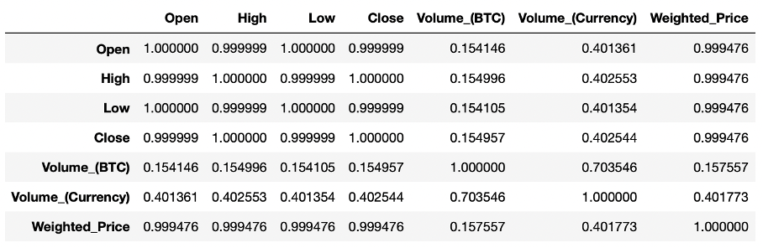
Correlation
Checking the correlation among all the variables, using the correlation matrix
Open x High x Low x Close = 0.9999 Open : High : Low : Close x Weighted_Price = 0.9994
Volume_(BTC) x Volume_(Currency) = 0.7035 Volume_(Currency) x Weighted_Price = 0.4017

Slide 6
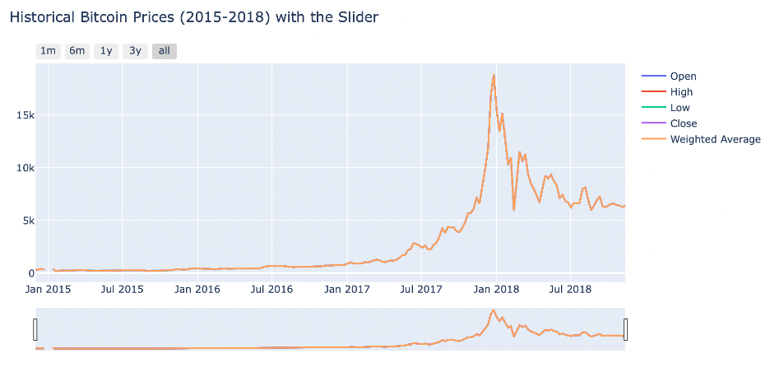
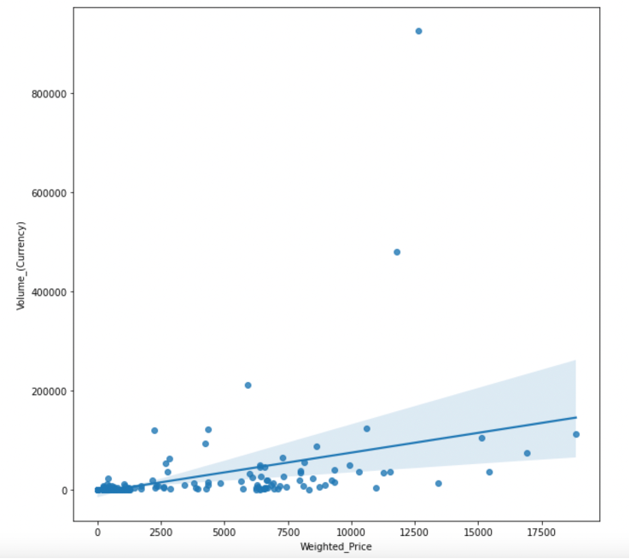
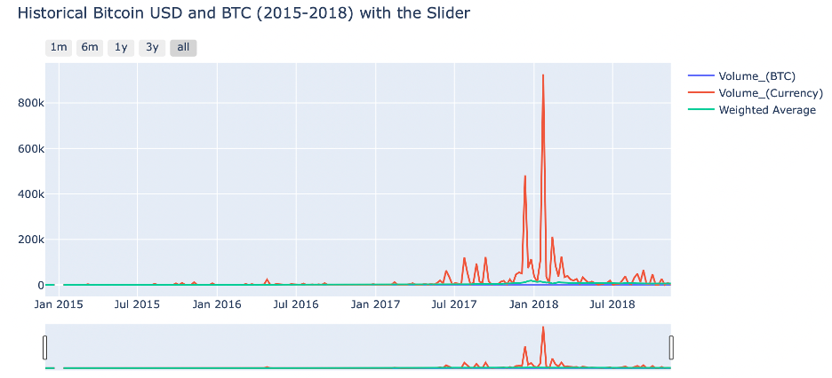
visualizations
Seen an increasing trend in the year 2017 for all the variables.
Close relation between Volume_(Currency) & Weighted_Price
Seen huge spikes in end of December 2017 & February 2018

Slide 7

Modelling

Slide 8



Data preparation for model fitting
Resampling
Replacing
Data split
Daily
Weighted_Price : Zero to NaN
NaN to Bfill
Volume Variables : NaN to Zero
​
Train : ~3.5 Years
Test : ~6 Months

Slide 9

stationarity
Stationarity means that the statistical properties(such as mean, variance, etc.) of a time series do not change over time.
What?
Reliable Inferences
​Expected Statistical Properties
Easier to apply Statistical Procedures
Why?
Dickey – Fuller Test : To check for stationarity.
​p – value < 0.05 : Stationary
p – value > 0.05 : Non - Stationary
Test

Slide 10
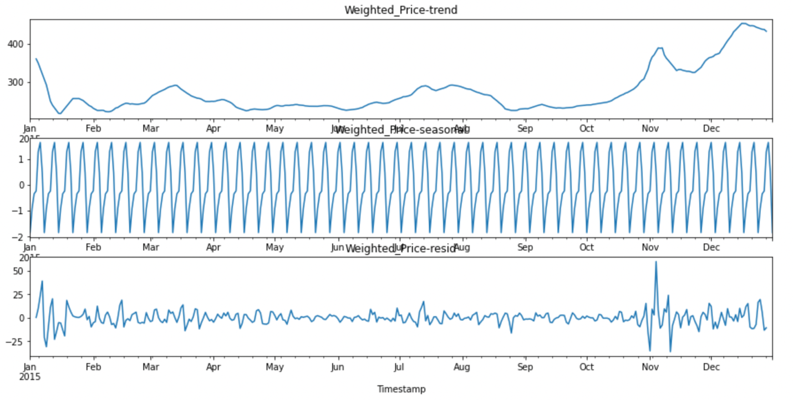
Seasonal Decompose (daily)
Trends
Seasonality
residuals
Time period​
Jan 1, 2015 to Dec 31, 2015
Target variable​
Weighted_Price
observation​
Similar pattern or Seasonal pattern is seen in each month for the whole year with four spikes representing each week of the month.
Dickey – Fuller Test : p – value = 0.44

Slide 11
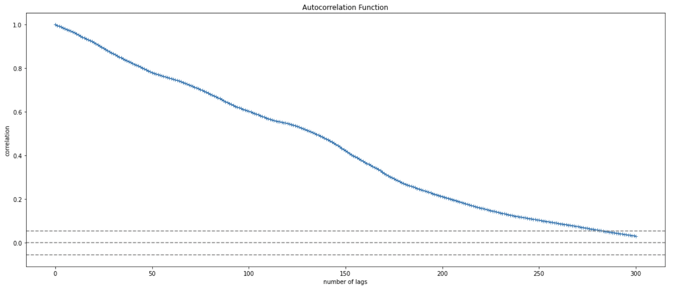
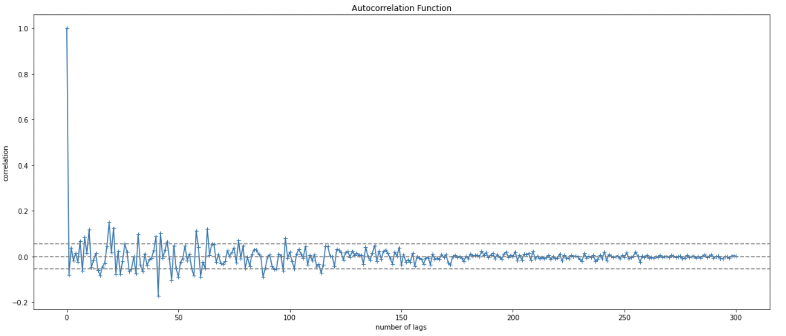
Auto-correlation
differencing
Measures the relationship between the Variable’s present value and past values
Method used to convert non– stationary series into stationary series
Dickey – Fuller Test : p – value = 0.00

Slide 12
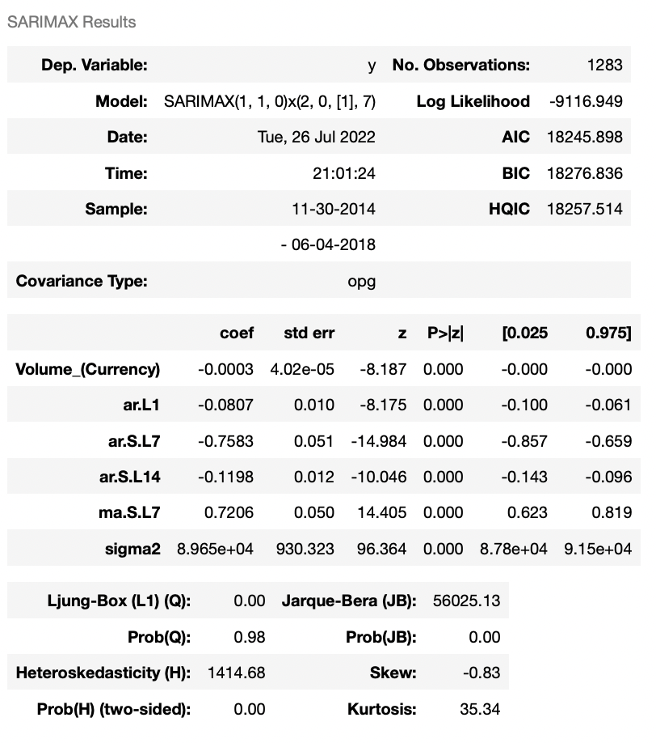

Auto - Arima
Auto-Regressive Integrated Moving Average
The model is used to understand past data or predict future data in a series.
Parts of ARIMA:
- Autoregressive Term (AR) - [P]
- Moving-Average Term (MA) – [Q]
sarimax​
Seasonal Auto-Regressive Integrated Moving Average with eXogenous factors is an extension of the ARIMA class of models.

Slide 13
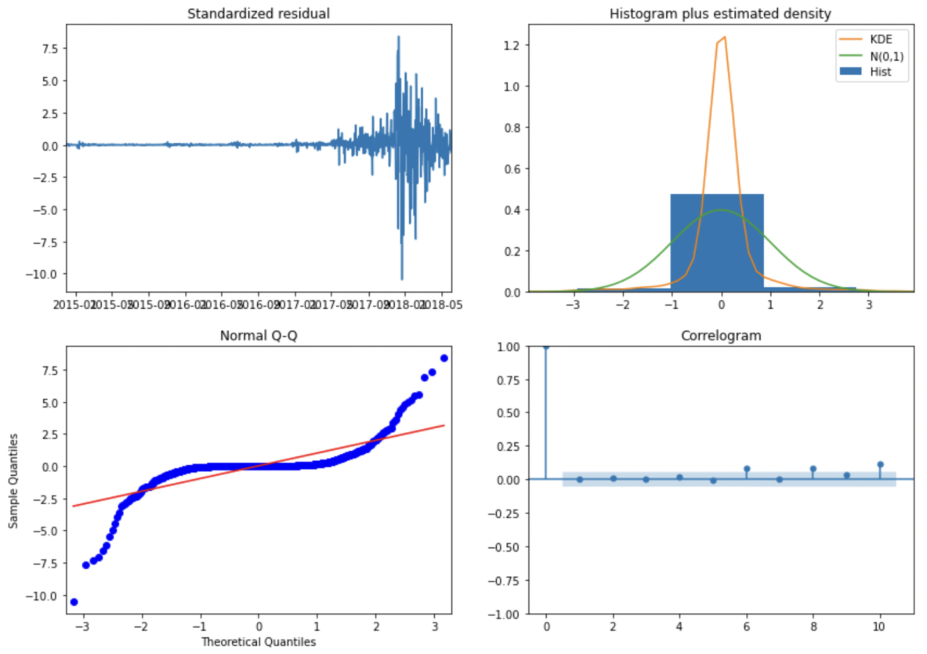
Residual analysis

Slide 14
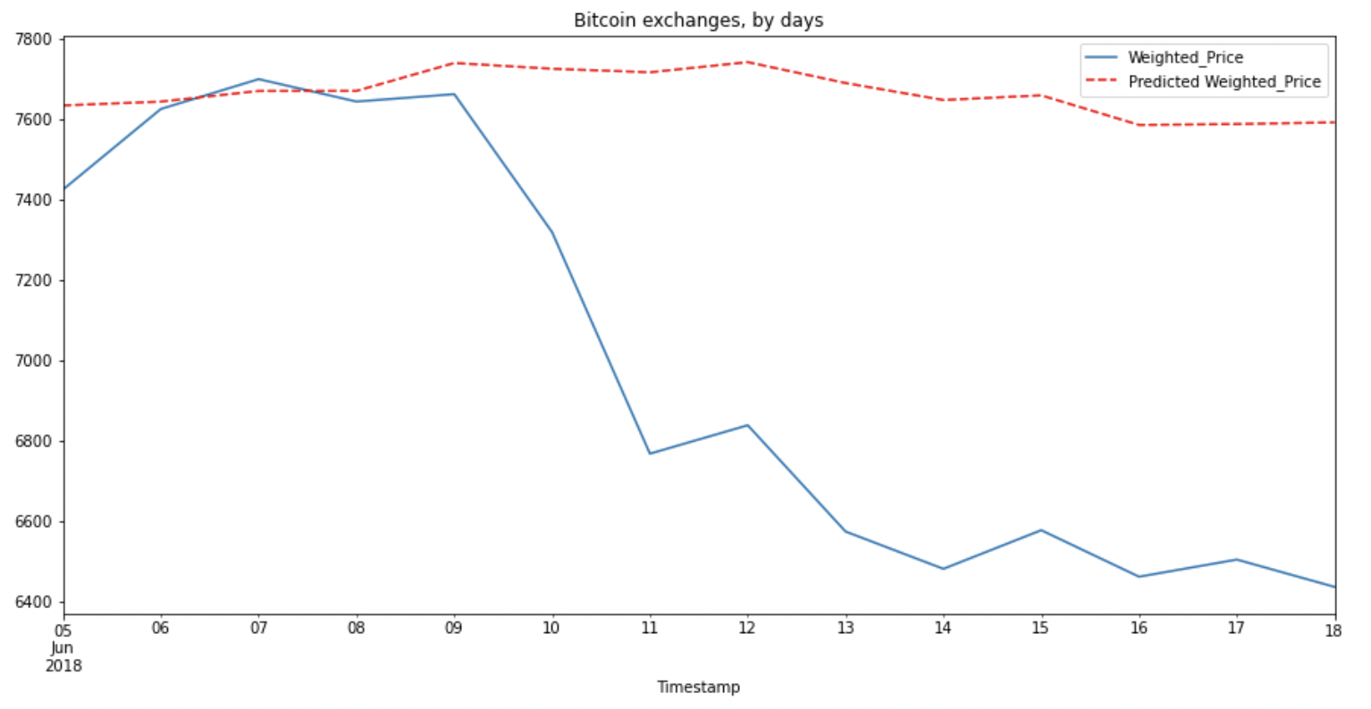
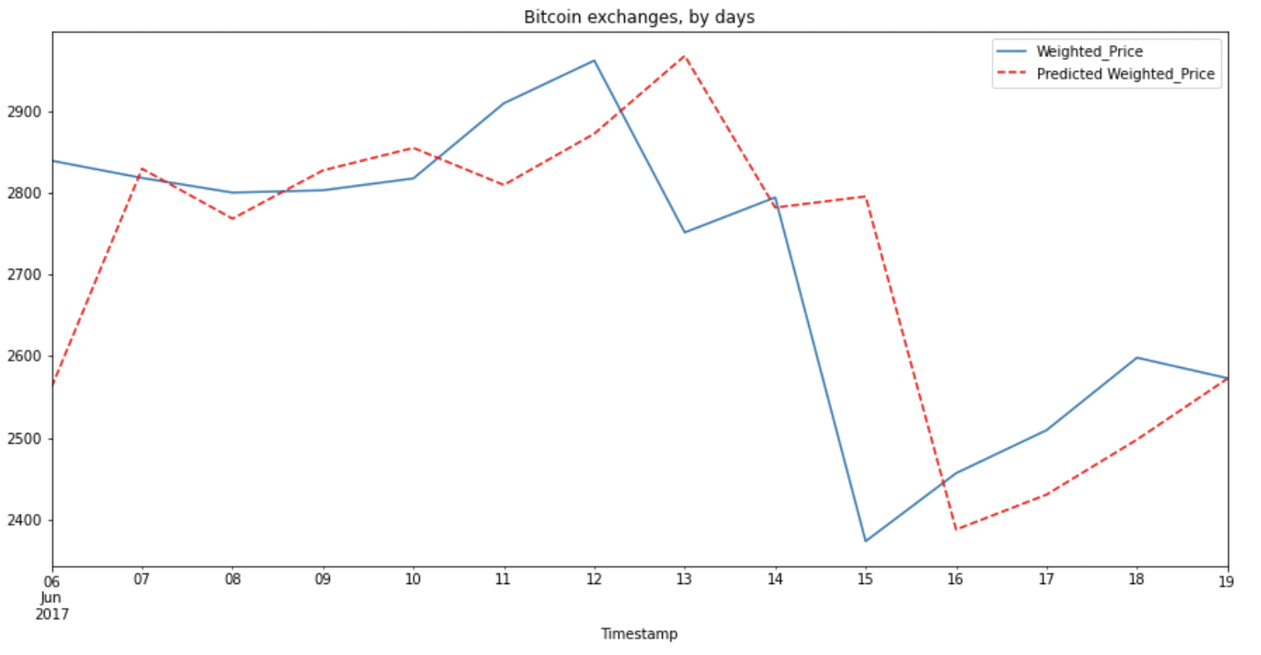
predictions
PREDICTION – TRAIN
RMSE = 296.58
PREDICTION – TEST
RMSE = 1106.35
MEAN = 6674.83
16.6%

Slide 15





Long short term memory
recurrent neural network
Neural Network

Slide 16
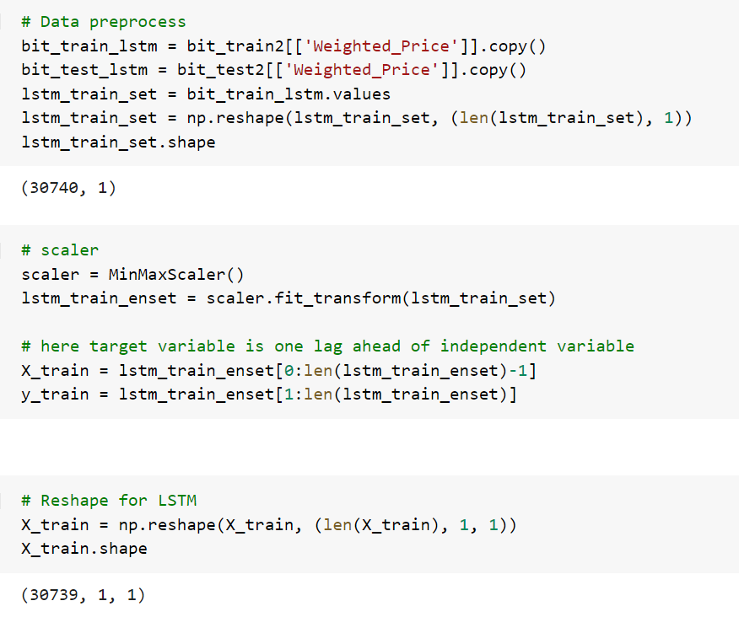
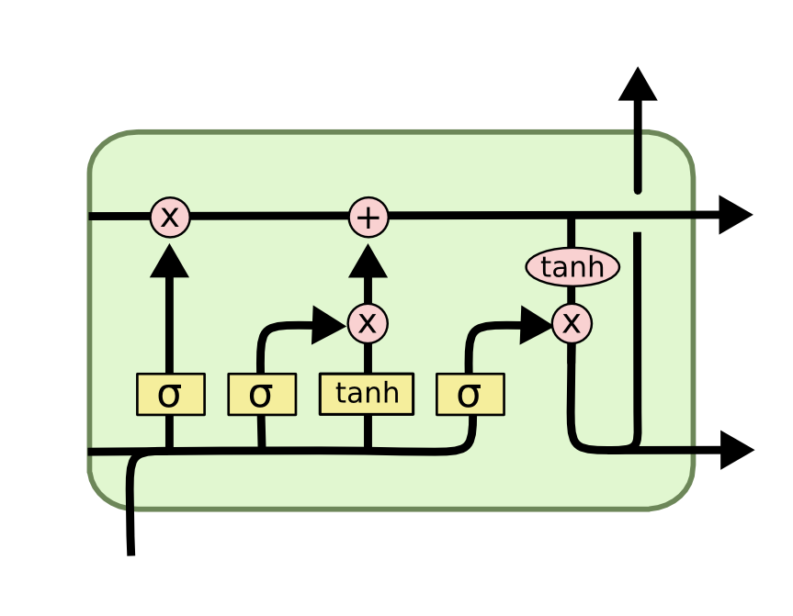
Long-short term memory
Long short-term memory (LSTM) is an artificial recurrent neural network (RNN) architecture used in the field of deep learning. Unlike standard feedforward neural networks, LSTM has feedback connections.

Slide 17
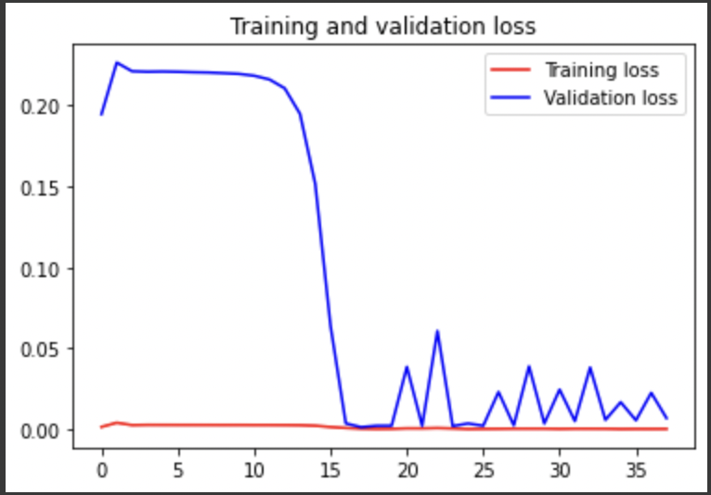
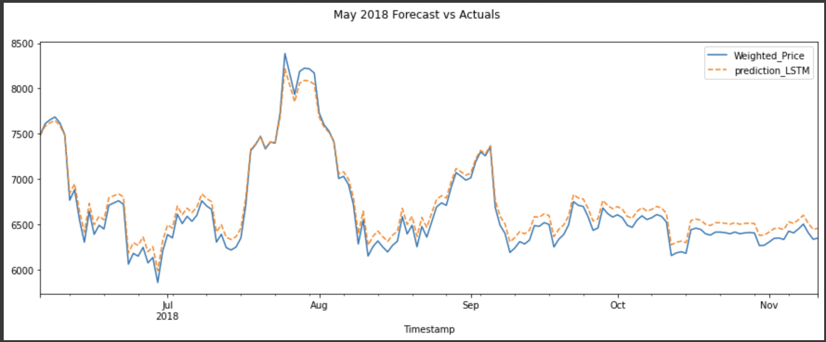
predictions
Total EPOCHs Fitted = 200
Total EPOCHs Executed (Early Stopping – Patience = 15) = 32
Validation & Training Loss were at Minimum at 17th EPOCH
TEST PREDICTION
CLOSELY FOLLOWS REAL VALUES
RMSE = 94.93

Slide 18
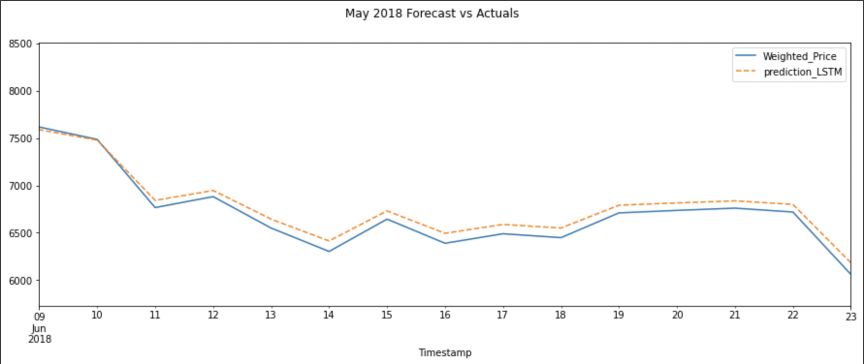
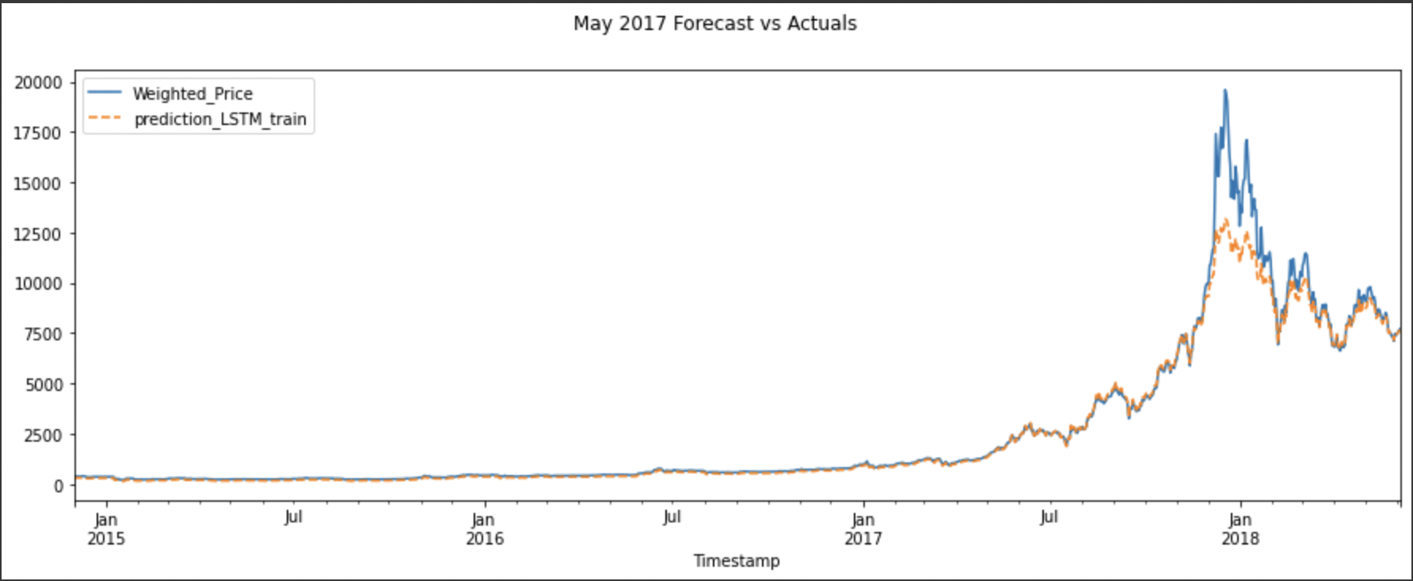
2 WEEKS TEST PREDICTION
RMSE = 86.10
TRAIN PREDICTION
CLOSELY FOLLOWS REAL VALUES
RMSE = 696.85

Slide 19
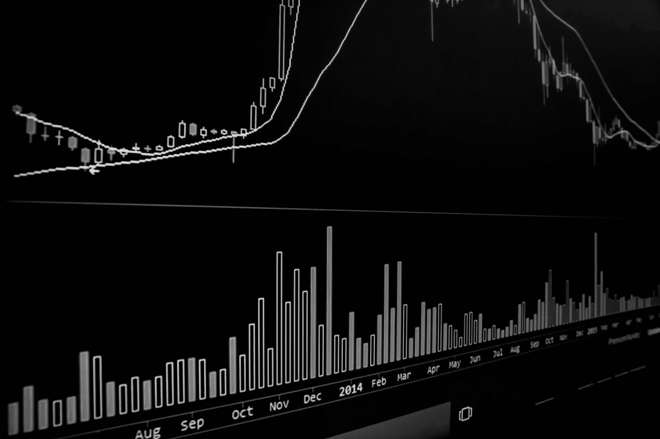
Sadly, We didn’t became millionaires

